Slide 1
Software Development Infrastructure for Successful Projects
This is CRUCIAL to success
By Dave Elliman
03/22/10
G53DBC
1

Slide 2
Document Management
A wiki (mediawiki or dokuwiki are good)
Indefero can be used for this
Knowledge Tree or similar is better
  http://www.knowledgetree.com/features
Trac is good for browsing changes, seeing project milestones and bug tracking
  http://trac.edgewall.org/
  Integrates with svn

Slide 3
Communication and coordination
Email
Shared calendar
Skype conference call (maybe Video)
Skype message board
Wiki us also useful
CI build also useful if emails and builds web page

Slide 4
Flexible team working?
Hot desking?
Work from home?
Work on the move?
Work in a virtual world?
  http://www.youtube.com/watch?v=4K_yLMMHTmE
What are the pros and cons?

Slide 5
Project Planning Tools
Microsoft Project very widely used
You could try dotProject
  http://www.dotproject.net/

Slide 6
We need a framework of developer tools
Revision control software
svn/Tortoise (or mercurial(hg) or git)
Test Suite
  JUnit or equivalent (go for annotation version)
Builder
  Ant or Maven
Documentor
  Doxygen (or javadoc)
Continuous Integration
  Cruise Control, Hudson (or build your own)

Slide 7

Bug Tracker/Project Planner
Project
progress
Programmers Editor
GUI Tool
Source code control
Intellisense
Wizards
Debugger
Configuration Manager
Continuous
Integration
Server
Various Browsers
IDE
Build Tool
Compiler and Linker
Unit Tester
Project Status
built/deployed
application
Documentation Generator
03/22/10
G53DBC
2
Deployment tool

Slide 8
Source Code Control
Sometimes call “Revision Control”
Recommendation for open source is SVN
  http://subversion.tigris.org/
Some people prefer git (used for Linux)
In fact Mercurial is the best (free) option (hg)
Commercial – Vault in fact free for one user. - http://www.sourcegear.com/vault/index.html
03/22/10
G53DBC
3

Slide 9
Use A Project Wiki and Issue Management Tool
Trac http://trac.edgewall.org/
This integrates with subversion
  http://www.hosted-projects.com/trac/TracDemo/Demo
Can be run from Apache or as its own server
Supports a project plan with Milestones, tickets for problems and a browser for the way the code has developed
Indefero is the same kind of thing…
03/22/10
G53DBC
14

Slide 10
You have indefero
http://www.indefero.net/
A clone of “GoogleCode”
No documentation on either!
https:/code.cs.nott.ac.uk

Slide 11
ScrumDesk looks interesting
Anyone using it?

Slide 12
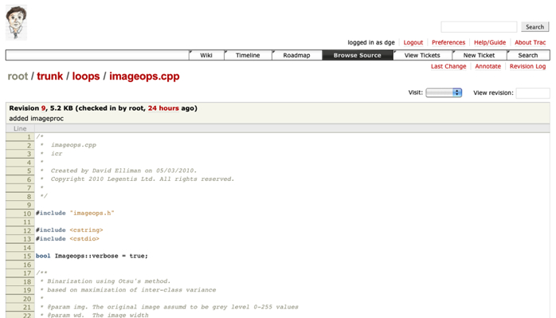
Browsing Source in the SVN Repository

Slide 13
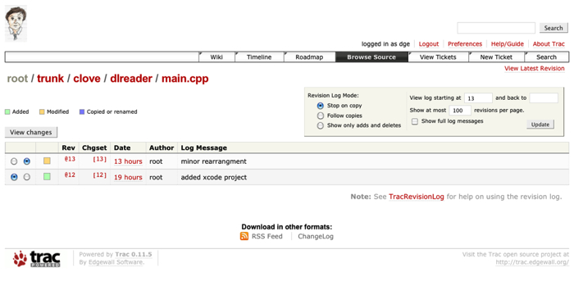
View recent changes

Slide 14
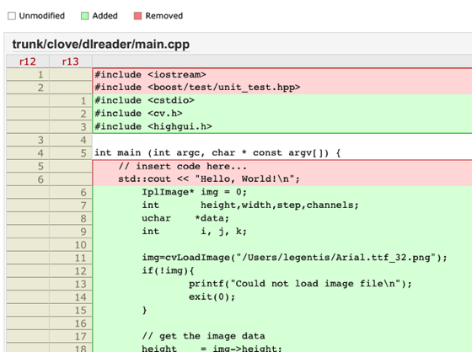
Viewing changes

Slide 15
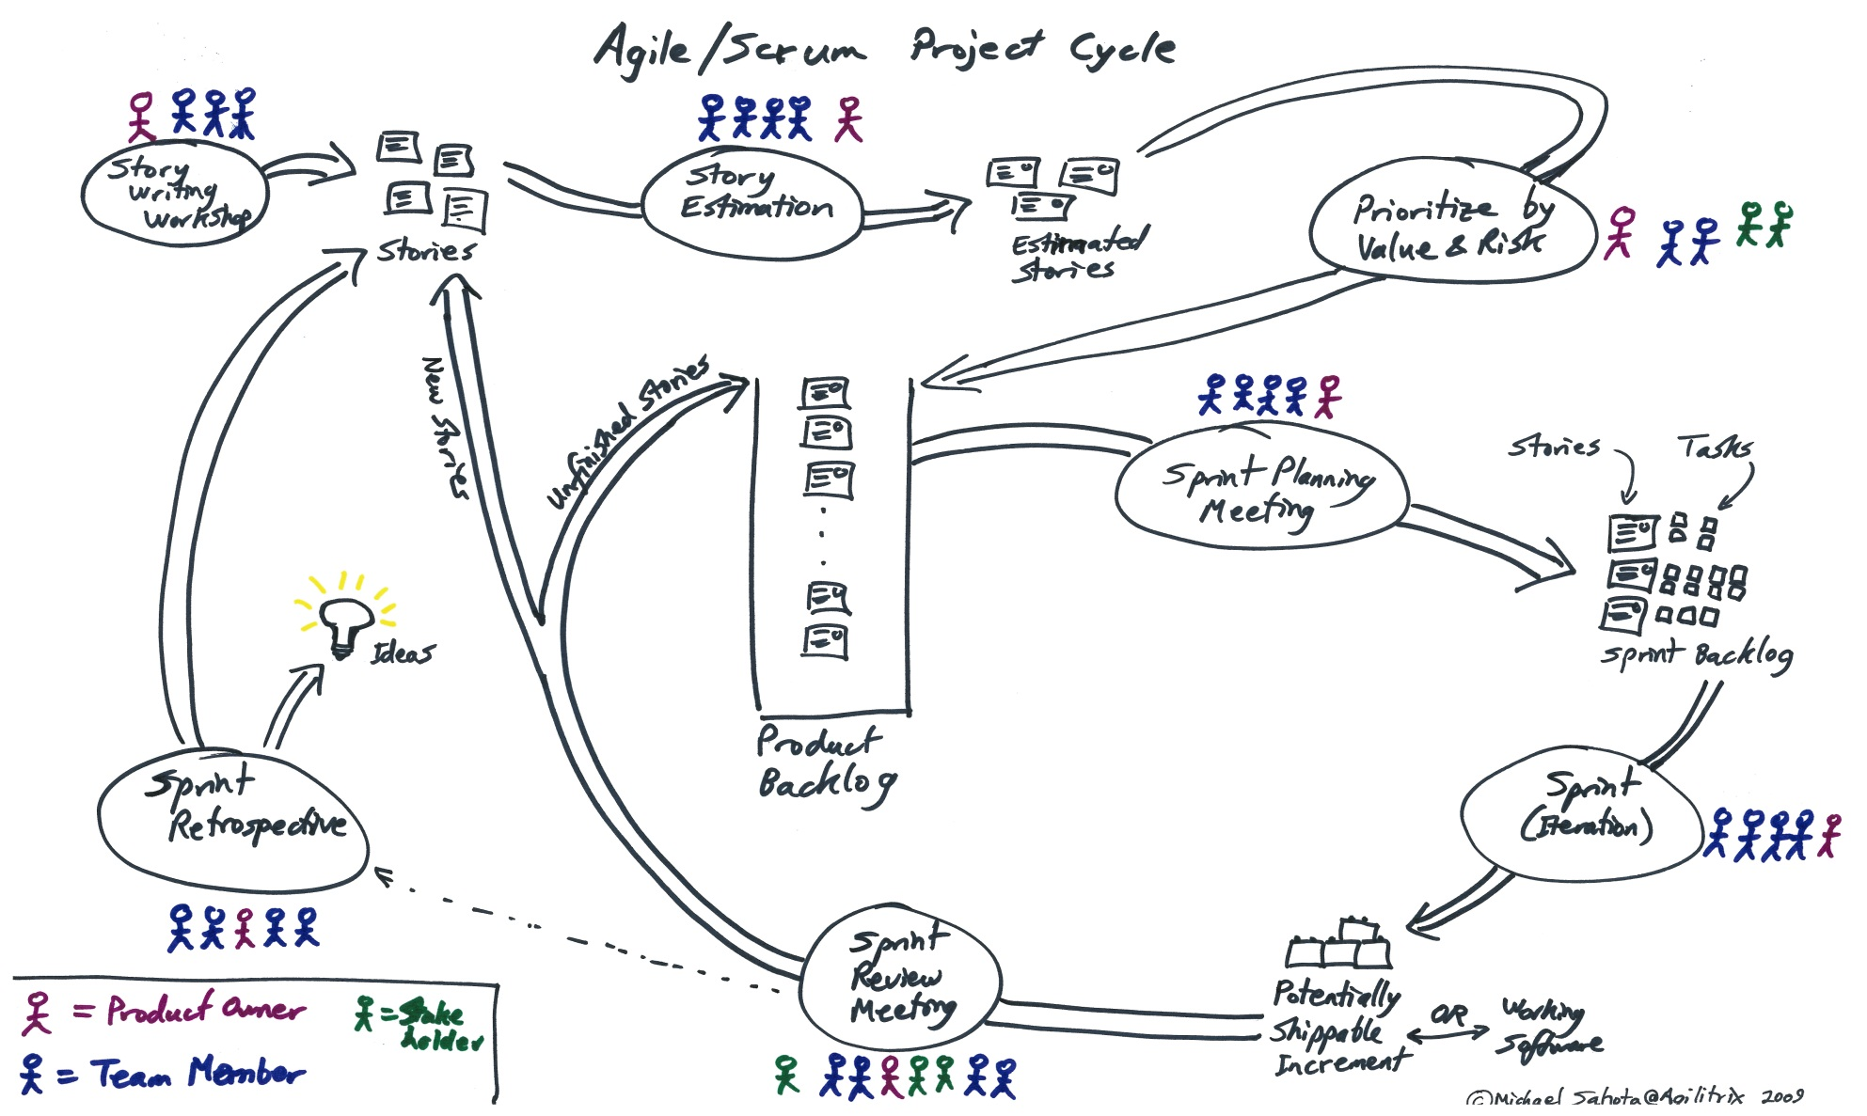
Agile Development- see agilitrix web site: http://www.agilitrix.com/2009/08/scrum-simulation-xpgame/

Slide 16
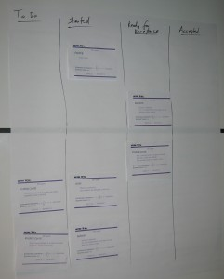

Slide 17
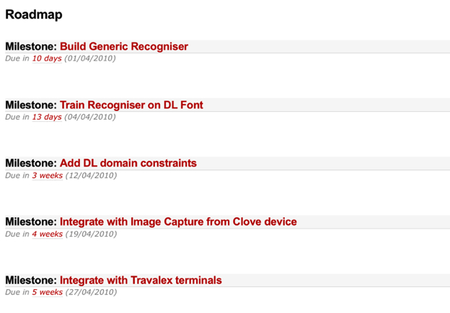
My task plan is in trac

Slide 18
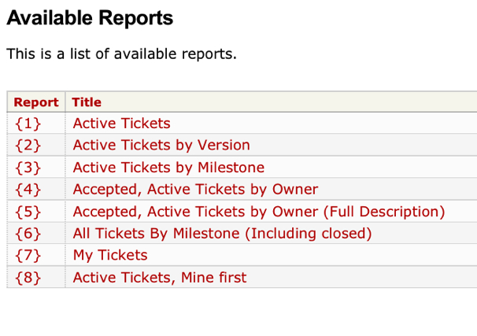
I keep track of bugs

Slide 19
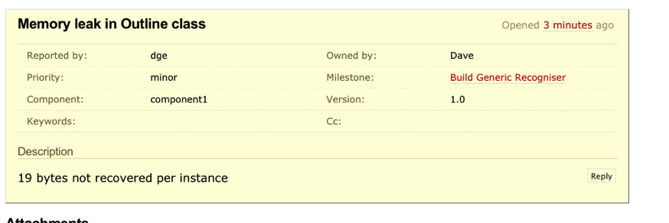
Browse bugs and note when fixed
Some useful statistics for estimating come out of this

Slide 20
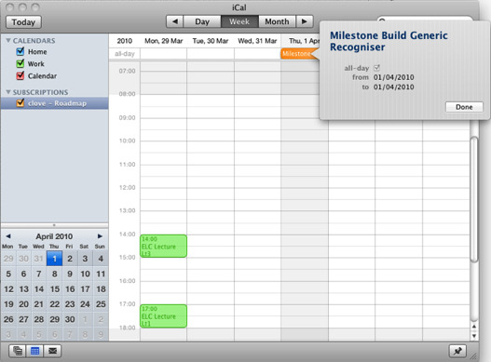
It integrates with iCal - on my desktop mac, laptop & iphone

Slide 21

I feel organised and “in control” of the codebase
I can view changes and go back in time
I can access a given release
My svn repository is on remote server which is incrementally backed up
I can branch off experimental sub-projects
I can build/test/document after an svn commit

Slide 22
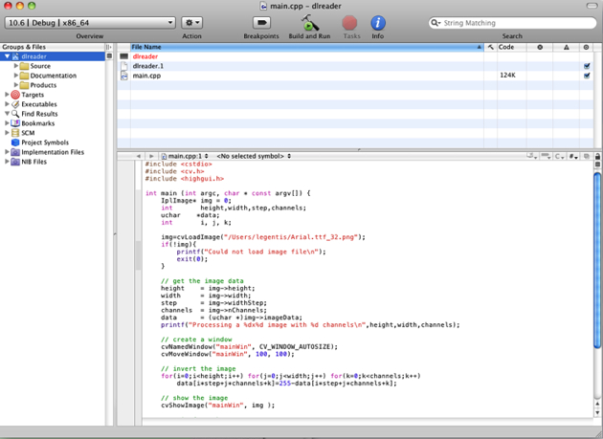
IDEs - xcode

Slide 23
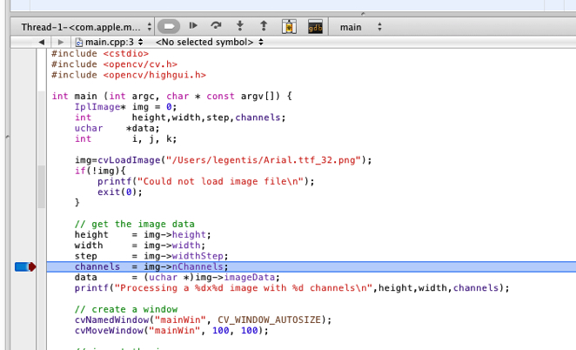
Breakpoints and stepping

Slide 24
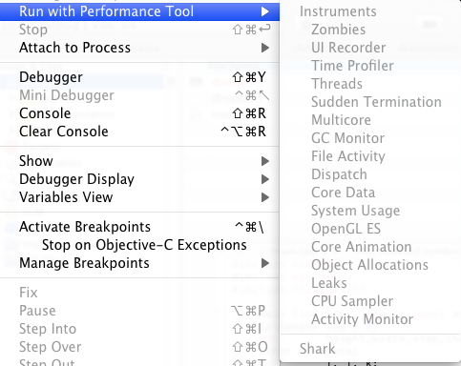
Instrumentation....

Slide 25
Alternatives
Visual Studio 2005/8/10 (Windows)
Eclipse
Net Beans (Java)
IntelliJ (Groovy/Java)
Wing IDE (Python)
Qt Creator (C++ and Qt)
JCreator/Bloodshed C++/Borland JBuilder
Quite a few others. I use Qt/VS/xcode/Wing

Slide 26
Instrumentation - others
Opensource tools - valgrind, profile, lint
Javabugs Checkstyle
I have DevPartner and AQtime for Windows development
Expensive but have no doubt repaid cost several times over

Slide 27
Continuous Integration
Hudson is great!
Cruise Control started it all
BuildBot possible for Python
See slides on Hudson and just use that

Slide 28
Unit (& other) Testing
Absolutely crucial!
Use a dynamic language (Python, Ruby Groovy) - BUT with Unit Testing
Functional tests too...
Web site testing - Selenium, Windmill, Cahoo (and more)
See slides on JUnit as the classic framework (Kent Beck)
I use Boost_Test and QTest(C++) Nose (Python)

Slide 29
Document generation
Javadoc the original but no longer the best
Doxygen - www.doxygen.org nice example here:
http://www.icu-project.org/apiref/icu4c/

